Slide 1


CMP 340 Project: Searching Methods
By Rohan, Prem & Hamad

Slide 2
Goals Of The Project
Analyze the Theoretical and Experimental efficiency of Binary Search and Interpolation Search
Compare Binary Search & Interpolation Search

Slide 3
Theoretical Analysis – Binary Search
Input: n integers in ascending order
Basic Operation: Comparison
Worst Case:
Recurrence: C(n) = C(⌊n/2⌋) + 1, C(1) = 1
Using Master Theorem: a=1, b=2, d=0. →Θ(n^0 log⁡n )=Θ(log⁡n).
Precisely, Θ(⌈log_2⁡(n+1)⌉)
Average Case:
Same as Worst Case = Θ(log⁡n)
Best Case:
Find the element right in the middle. Θ(1)

Slide 4
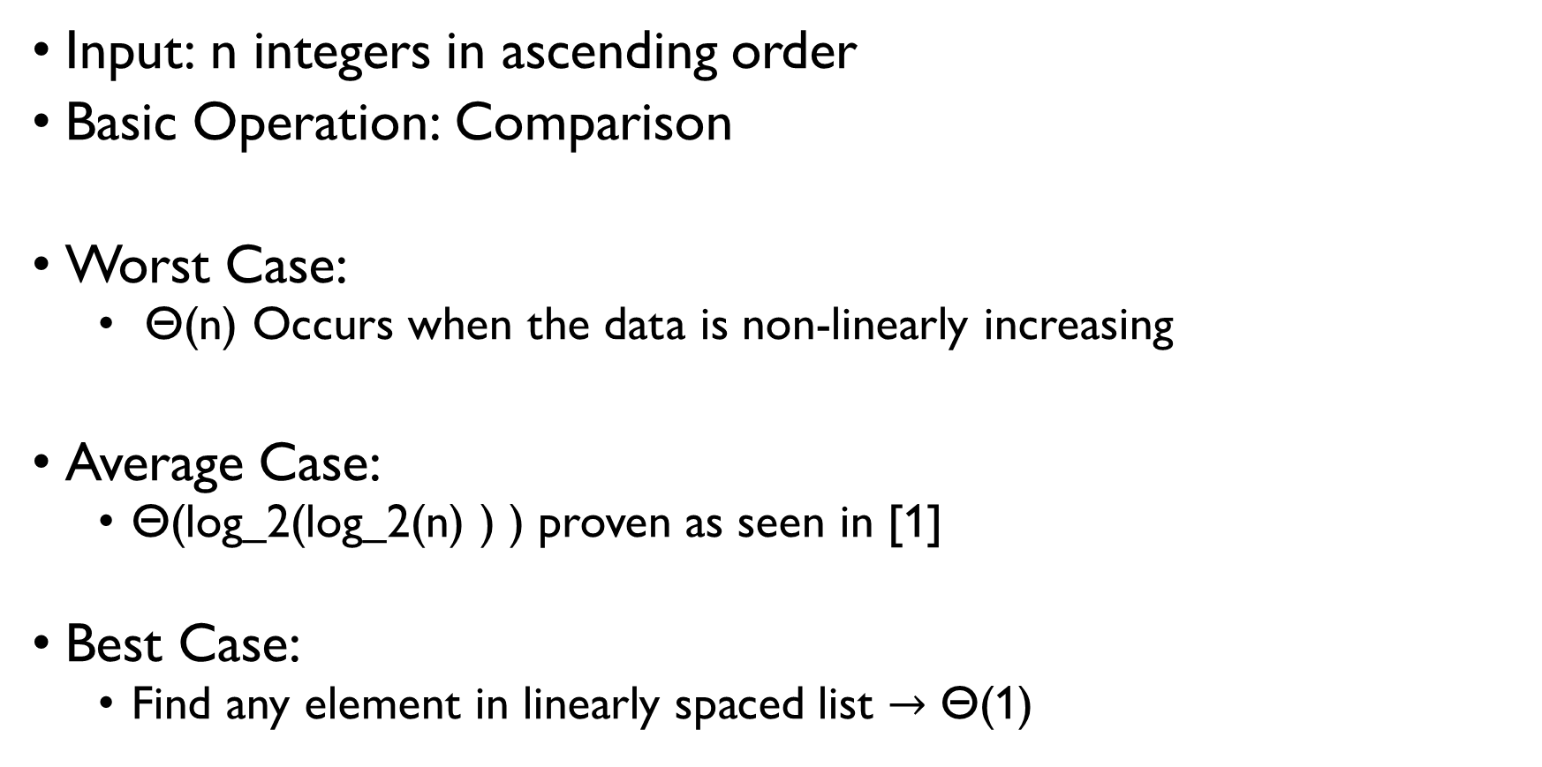
Theoretical Analysis – Interpolation Search
Input: n integers in ascending order
Basic Operation: Comparison
Worst Case:
Θ(n) Occurs when the data is non-linearly increasing
Average Case:
Θ(log_2⁡(log_2⁡(n) ) ) proven as seen in [1]
Best Case:
Find any element in linearly spaced list $→$ Θ(1)

Slide 5
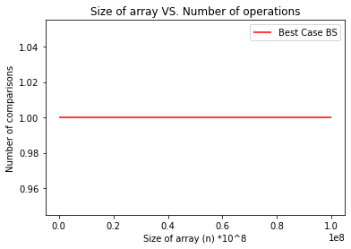
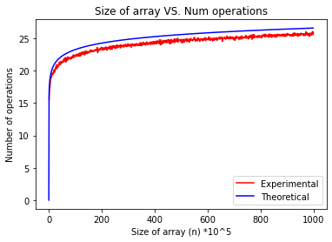
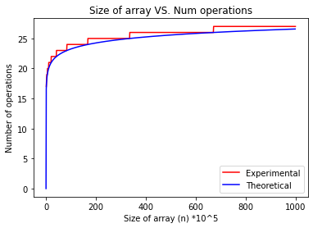
Experimental Analysis – Binary Search
Input - linearly spaced every 10^5, lengths in order of 10^5 (n ranges from 10^5 to 10^8, increments of 10^5).
Best: Average: Worst:
Code and results can be found at [2]

Slide 6
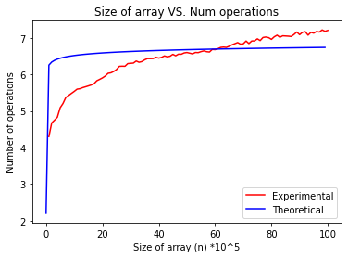
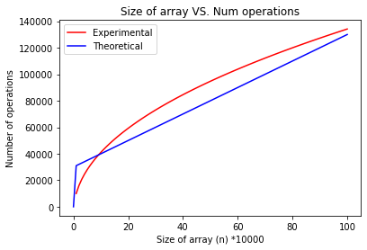
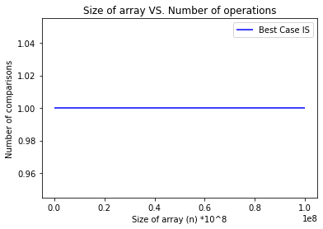
Experimental Analysis – Interpolation Search
Input – n between 10^4 and 10^6 for Quadratically spaced elements.
Best: Average: Worst:
The last element was made exceptionally large (multiplying by 1000) for worst case
Code and results can be found at [2]

Slide 7
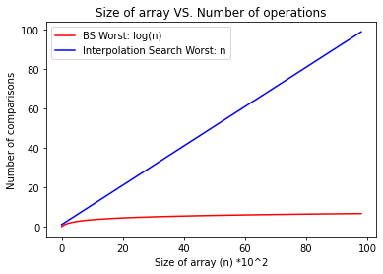
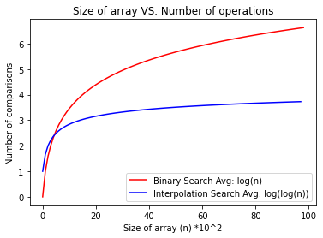
Binary Search vs. Interpolation Search
Best Case is same
Worst Cases: Average Cases:
IS only use when each comparison is computationally expensive, or array is VERY large

Slide 8

Our Animation
Code and results can be found at [2]

Slide 9
References
[1] S. Yuan, “Understanding the complexity of interpolation search.” https://cadmo.ethz.ch/education/lectures/HS18/SAADS/reports/17.pdf.
[2] Github.com/ro1406. “CMP340Project”. https://github.com/ro1406/CMP340Project

